Slide 1
JUSTCHAT
GUIDED BY, SUBMITTED BY,
AJITH G.S JUSTIN V KALAPPURA

Slide 2
INTRODUCTION :
A social network service which focuses on the building and verifying of online social networks on which we can personally share their own interests on common social issues, which will can be seen by all the users of this platform.
Plus adding a feature of crowdfunding implementation in blockchain to the social media. So as to overcome many shortcomings in the existing system of social media crowdfunding.

Slide 3
DRAWBACKS OF EXISTING SYSTEM:
The main purpose of the system is to replace the existing manual system.
Some of the main problems encountered in existing system are follows.
• Making them less aware of the things happening around.
• Making people living in a virtual world by not having any
opinion.
• Pressurizing the new generation to follow the old methods.
• Not having a good transparent system for helping others
financially.

Slide 4
ADVANTAGES OF PROPOSED SYSTEM:
• Can make a major change with less effort.
• Make new generation aware about the things happening around.
• Promotes the people having their own opinion.
• Along with the entertainment can also make them updated.
• Good feature to have a transparent crowdfunding.

Slide 5
IMPLEMENTATION:
➢Implementation of software refers to the final installation of the package
in its real environment, to the satisfaction of the intended uses and the
operation of the system.
In many organizations someone who will not be operating it, will commission the software development project. In the initial stage people doubt about the software but we have to ensure that the resistance does not build up, as one has to make sure that:
➢ The active user must be aware of the benefits of using the new system.
➢ Their confidence in the software is built up.

Slide 6
CONCLUSION:
The analysis shows that our system “JUSTCHAT (social media platform)” is better product for doing social upliftment in a society.
The existing systems are very poor and inefficient in this concern. The new system that be introduced is effective, efficient and simple in managing and molding a socially aware community or society.
This will surely be an solution to many problems to the existing systems.

Slide 7
FUTURE SCOPE:
➢ Additional security features can be implemented ie by making the same application into a web 3.0 application fully using technologies like blockchain.
➢ A mobile application can be developed for this system so that to make a socially aware society around us. So that we can make the application use it more freely.
➢ Real time news can be made visible.
➢ Can be made efficient or profitable by making a space to show the ads our application.

Slide 8
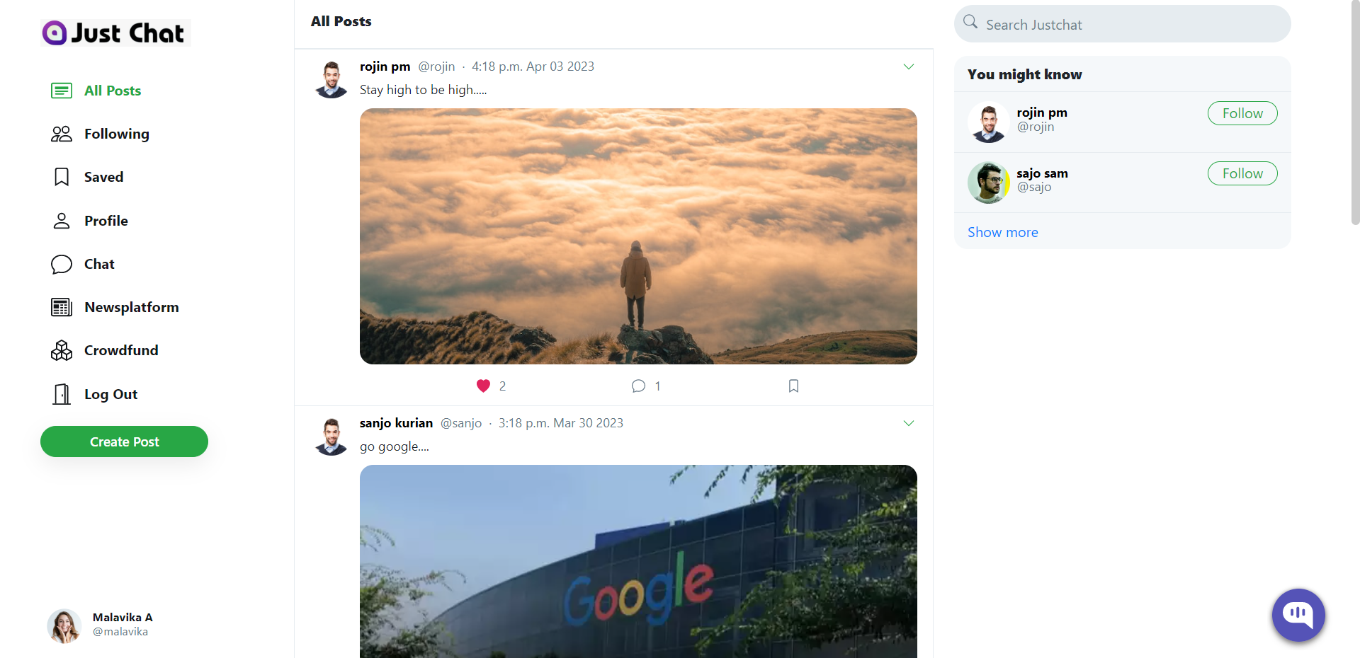
SCREENSHOT:

Slide 9
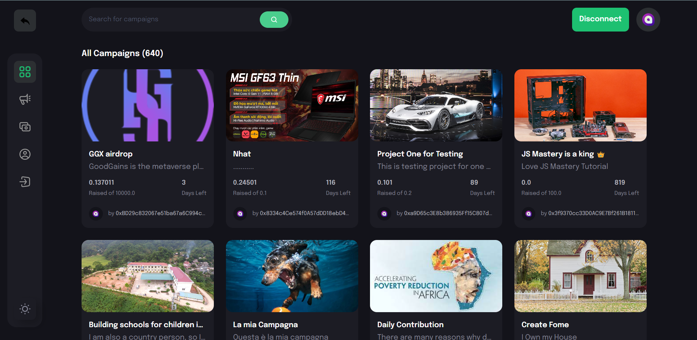

Slide 10
